Slide 1

Tutorial 1: MapReduce
Ao Zhang
aozhang@u.nus.edu

Slide 2
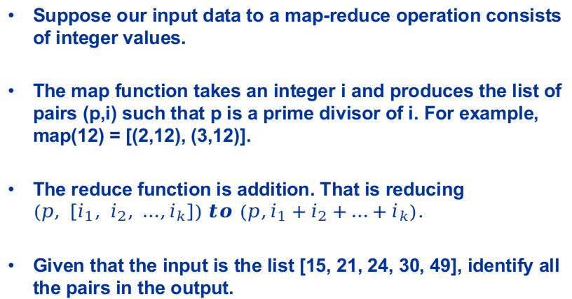
Question 1
Suppose our input data to a map-reduce operation consists of integer values.
The map function takes an integer i and produces the list of pairs (p,i) such that p is a prime divisor of i. For example, map(12) = [(2,12), (3,12)].
The reduce function is addition. That is reducing $\left(p, \left[i_{1}, i_{2}, …,i_{k}\right]\right) to \left(p,i_{1}+i_{2}+…+i_{k}\right).$
Given that the input is the list [15, 21, 24, 30, 49], identify all the pairs in the output.
Notes:
So in this question, the map function has been

Slide 3
Solution 1
Then group by keys:
(2, [24,30])
(3, [15,21,24,30])
(5, [15,30])
(7, [21,49])
Reduce add elements:
(2,54)
(3,90)
(5,45)
(7,70)
Map does the following:
15 -> (3,15), (5,15)
21 -> (3,21), (7,21)
24 -> (2,24), (3,24)
30 -> (2,30), (3,30), (5,30)
49 -> (7,49)

Slide 4
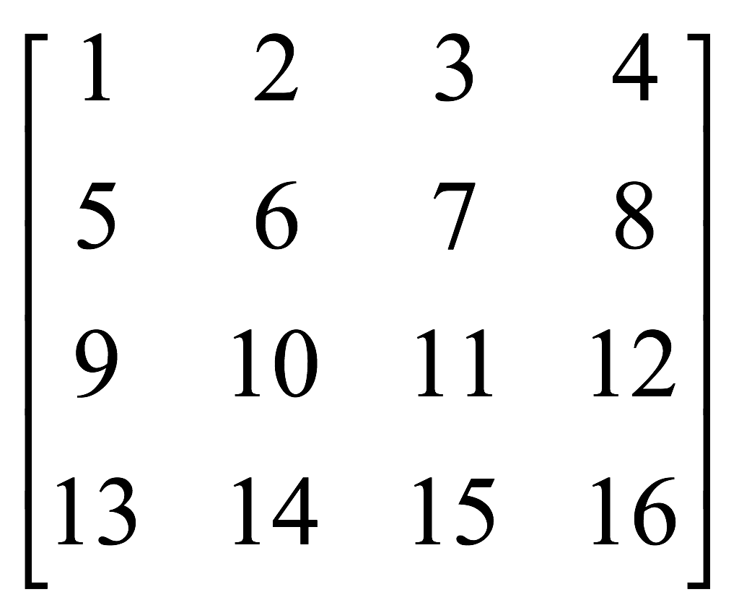

Question 2
We have a large matrix (n x m, and n >> m) that cannot be stored on a single machine. So we distribute it on a cluster of machines. We want to compute the result of matrix-vector multiplication. Since n >> m, the vector is stored on every machine of the cluster.

Slide 5
Question 2
The input to the mapper function is (value, row, col). And vector v is already known to each mapper:
Design a suitable map and reduce function, and identify all the pairs in the output.

Slide 6
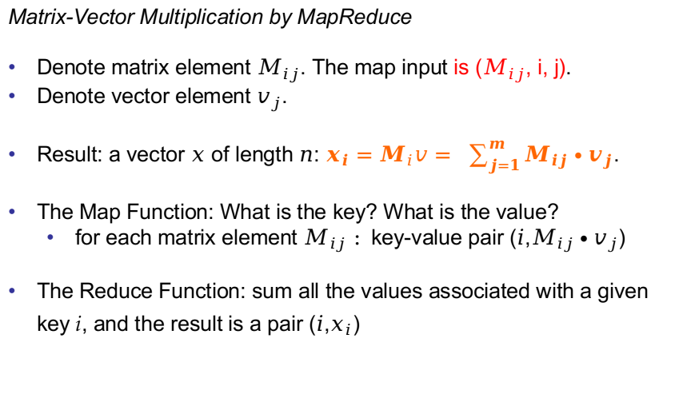
Solution 2
Matrix-Vector Multiplication by MapReduce
Denote matrix element $M_{ij}$. The map input is ($M_{ij}$, i, j).
Denote vector element $v_{j}$.
Result: a vector $x$ of length $n$: $x_{i}=M_{i}v= \sum_{j=1}^{m}{M_{ij}∙v_{j}}$.
The Map Function: What is the key? What is the value?
for each matrix element $M_{ij} :$key-value pair ($i$,$M_{ij}∙v_{j}$)
The Reduce Function: sum all the values associated with a given key 𝑖, and the result is a pair ($i$,$x_{i}$)

Slide 7
Solution 2
Map: Thus, in row-major order, the sixteen key-value pairs produced are:
Reduce: sum the values corresponding to the same key, thus, results of reduce are: (1,30), (2,70), (3,110), (4,150)

Slide 8
Question 3
Consider a simple example:
We have a large dataset where input keys are strings and input values are integers.
We wish to compute the mean of all integers associated with the same key.
A real-world example might be a large user log from a popular website, where keys represent user ids and values represent some measure of activity such as elapsed time for a particular session.
A program Tommy has implemented the problem on MapReduce. He has written a few versions with the pseudo code shown in Figures 1—3.
Notes:
We can assume this is the result of word count on every single document
Which is the occurrence of word on the whole dataset..

Slide 9
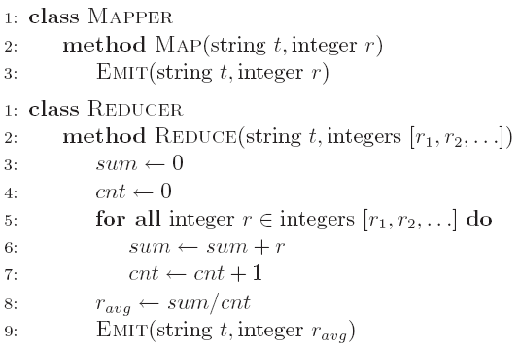
Question 3a
a) Initially, Tommy has finished an implementation with Version 1 (Figure 1).
He finds that the implementation can have correct results, but the performance is very slow. Why?

Slide 10
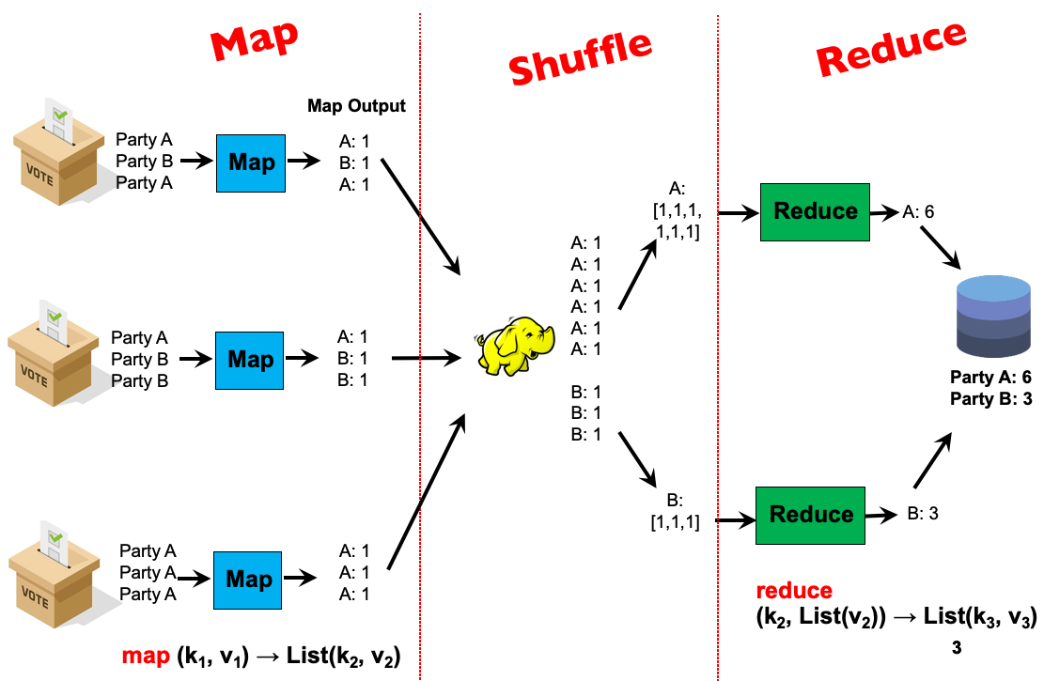
Solution 3a
It requires shuffling all key-value pairs from mappers to reducers across the network, which is highly inefficient.

Slide 11
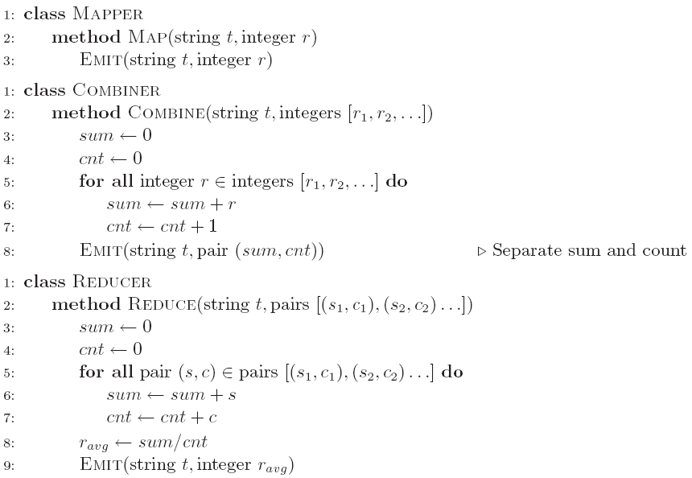
Question 3b
b) Tommy wants to improve the performance using combiner. He comes out the second implementation (Version 2 in Figure.
Analyze the correctness of the combiner and efficiency of the algorithm (i.e., why it is more efficient than Version 1).

Slide 12
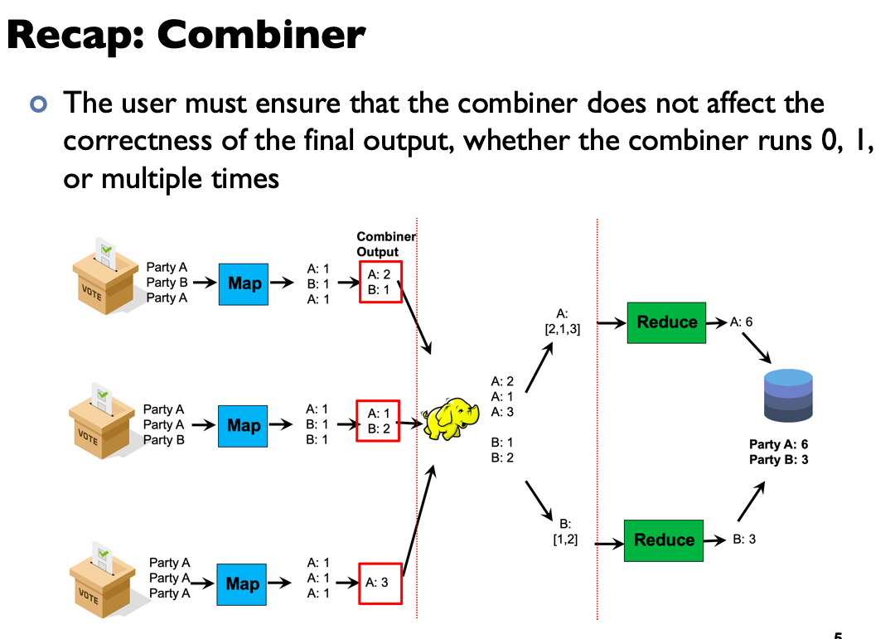
Solution 3b
Amount of data transmission has been reduced

Slide 13
Question 3b
b) He finds that he can seldom get the reasonable results. Why?

Slide 14
Question 3b
Combiner must have the same input and output key-value type

Slide 15
Solution 3b
Recall that combiners must have the same input and output key-value type, which also must be the same as the mapper output type and the reducer input type.
To understand why this restriction is necessary in the programming model, remember that combiners are optimizations that cannot change the correctness of the algorithm. The user needs to ensure that the program output is still correct, regardless of whether the combiner runs 0, 1, or multiple times.
If the combiner does not run (that is, the map output is fed directly to the reduce function), the output value type of the mapper is integer, so the reducer receives a list of integers as values. But the reducer actually expects a list of pairs!

Slide 16
Solution 3b
Does this mean the number of times the combiner runs is not deterministic? It is decided by the Hadoop framework, with no guarantees provided to the user on how many times it will run (note: the question of exactly how many times the combiner will run is an implementation detail that is out of syllabus)

Slide 17
Solution 3b
The problem lies in that the combiner might not be called on all the output key-value pairs of the map phase. As a result, code 3b will produce inconsistent key-value pairs, as the mapper output type is different from the combiner output type. If the combiner runs 0 times, then the input type of the reducer is mismatched with the output type of the mapper. Thus the program would fail.

Slide 18
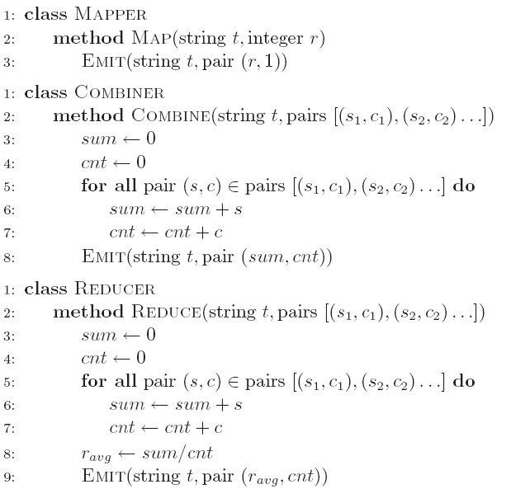
Question 3c
c) After careful design, Tommy finally develops an efficient and correct implementation (Version 3 in Figure 3). Analyze the correctness of the combiner and efficiency of the algorithm (i.e., why it is more efficient than Version 1).

Slide 19
Solution 3c
Correctness: output of Mapper, input of Combiner, output of Combiner, and input of Reducer share the same format. No matter how much times Combiner is called, the results are the same. In addition, Combiner only calculate the sum and cnt, leaving the mean (sum/cnt) for the Reducer.
Efficiency: alleviate the burden of shuffling a large amount of key-value pairs across the network.

Slide 20
Summary
Mapper and Reducer is the key operation of divide and conquer.
Combiner is an optimization step to reduce the amount of data transmission.
Leverage the design of MapReduce program (How to partition the data).

